Slide 1

Bioinformatics Bootcamp
Fall 2020: “Programming Fundamentals and RNA-Seq analysis”
Week 3: The Tidyverse

Slide 2
Outline
Recap of last week’s tidyverse basics
Using statistics ggpubr and the titanic dataset
Comparing fare price to survival
Analyzing biological data with tidyverse and ggpubr
Luminescence data from a plate reader assay

Slide 3
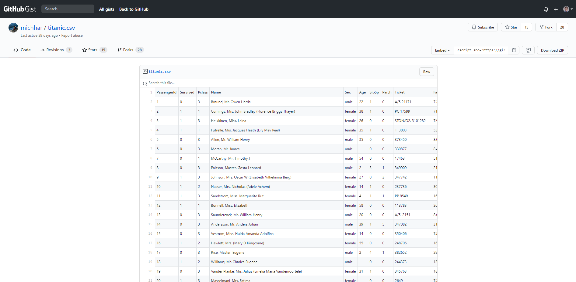

Slide 4
The pipe operator
data %>% function(arguments)
data %>%
f1() %>%
f2() %>%
f3()
data_tidy <- data %>%
f1() %>%
f2() %>%
f3()
function(data, arguments)
f3(f2(f1(data)))
data1 <- f1(data)
data2 <- f2(data1)
data_tidy <- f3(data2)

Slide 5
Commonly used verbs in a pipeline
pct_surv <- tidy_titanic %>% filter(Age > 12) %>% select(Survived, Sex) %>% group_by(Sex, Survived) %>% summarise(num_sex_survive = n()) %>% mutate(pct_sex_survive = num_sex_survive/sum(num_sex_survive) * 100) %>% filter(Survived == 1)
pct_surv

Slide 6
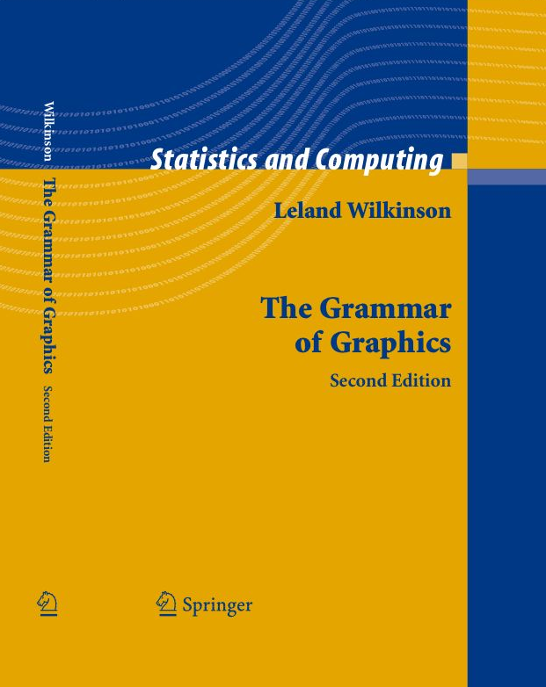
The Grammar of Graphics
A structured language for plotting
All plots follow this language
Key components:
Data
Aesthetics
Geometries
Facets
Statistics
Coordinates
Theme
https://www.cs.uic.edu/~wilkinson/TheGrammarOfGraphics/gog2.jpg

Slide 7
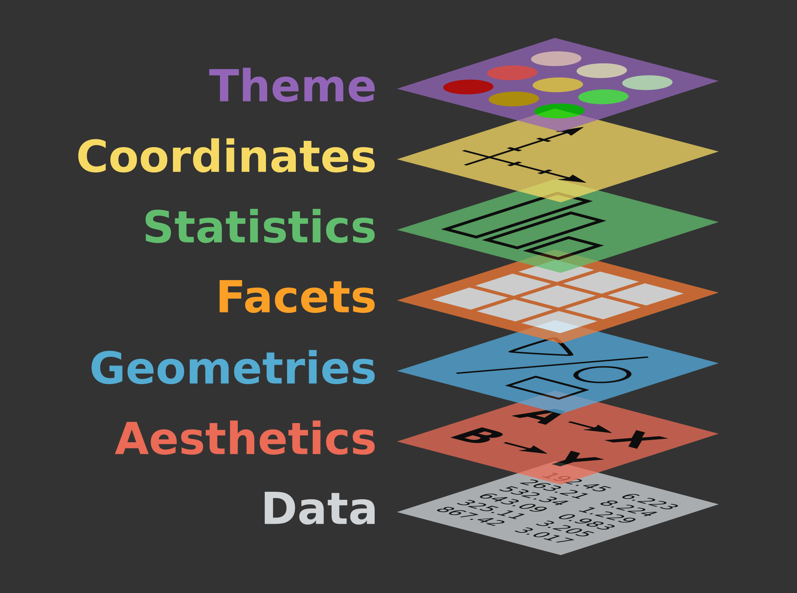
https://ggplot2.tidyverse.org/reference/index.html
Source: https://www.catallaxyservices.com/media/Grammar-Of-Graphics/#/3/3

Slide 8
Commonly used layers in a plot
ggplot(data = pct_surv, mapping = aes(x = Sex, y = pct_sex_survive, fill = Sex)) + geom_bar(stat = "identity") + ylab("Percentage Surviving") + labs(title = "Effect of Sex on Survival aboard the Titanic") + theme_classic(base_size = 17) + xlab(NULL) + theme(legend.position = "none") + scale_y_continuous(limits = c(0, 100), expand = c(0, 0)) + scale_x_discrete(labels = c("Female", "Male"))

Slide 9
Last lecture’s data wrangling and plotting
read_csv("https://gist.githubusercontent.com/michhar/2dfd2de0d4f8727f873422c5d959fff5/raw/fa71405126017e6a37bea592440b4bee94bf7b9e/titanic.csv") %>% # Read the data into a tibble filter(Age > 12) %>% # Only keep passengers with known Age select(Survived, Sex) %>% # Only keep the Survived and Sex columns group_by(Sex, Survived) %>% # Group by Sex and then Survived summarise(num_sex_survive = n()) %>% # Count the number of passengers in these groups mutate(pct_sex_survive = num_sex_survive/sum(num_sex_survive) * 100) %>% # Calculate the percent surviving filter(Survived == 1) %>% # Only keep the surviving passengers ggplot(mapping = aes(x = Sex, y = pct_sex_survive, fill = Sex)) + # Build the data and aesthetic layers geom_bar(stat = "identity") + # Build the geometric layer as a bar plot ylab("Percentage Surviving") + # Make a Y axis label labs(title = "Effect of Sex on Survival aboard the Titanic") + # Add a title theme_classic(base_size = 17) + # Increase the font size and set a nice theme xlab(NULL) + # Remove the X axis label theme(legend.position = "none") + # Remove the legend scale_y_continuous(limits = c(0, 100), expand = c(0, 0)) + # Set Y axis limits and remove the expansion scale_x_discrete(labels = c("Female", "Male")) + # Capitalize the X axis Sex labels ggsave(filename = "my_fig.png", width = 7, height = 4.5)

Slide 10
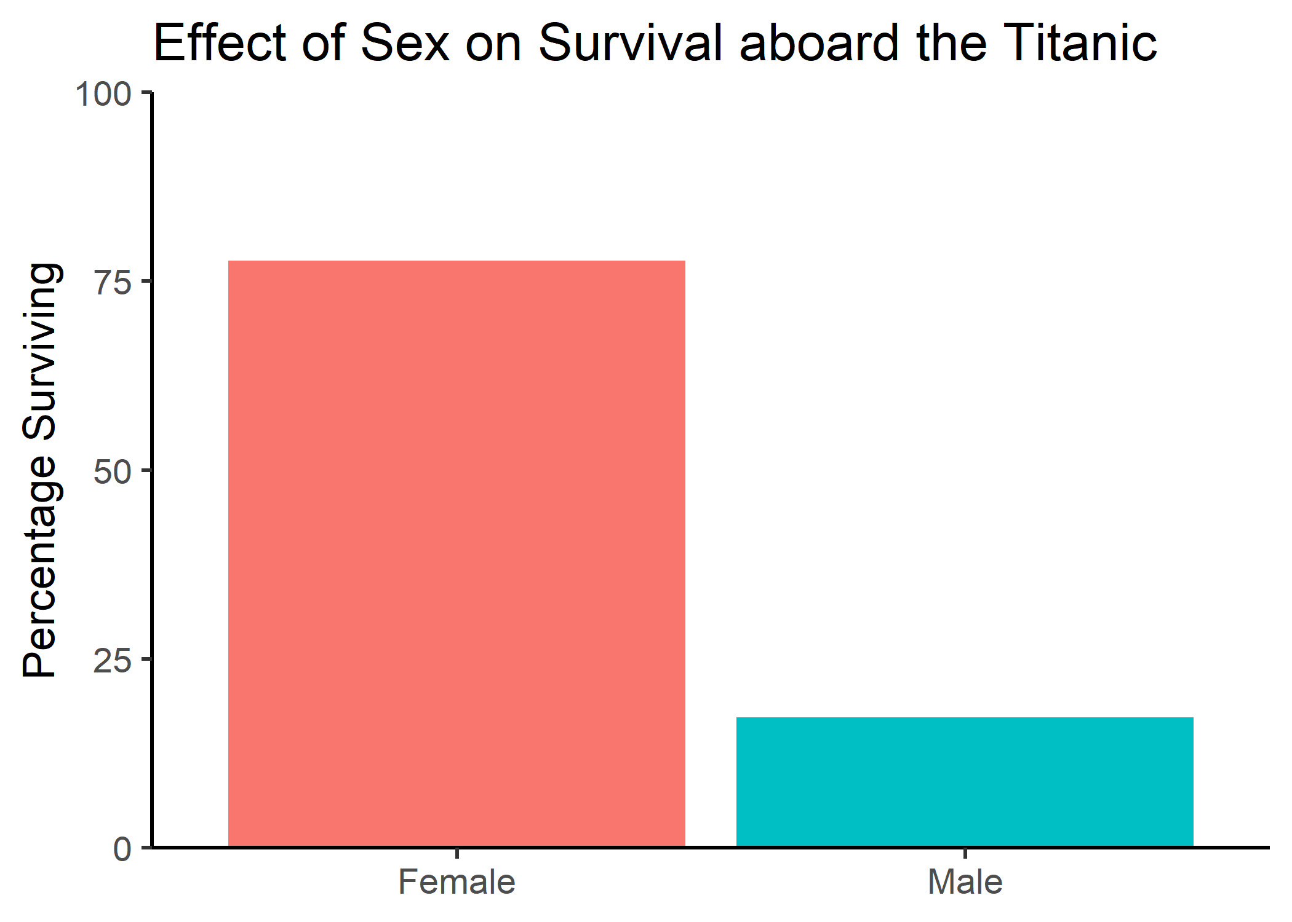

Slide 11
Using statistics with ggpubr

Slide 12
Does Fare predict Survival?
titanic <- read_csv("https://gist.githubusercontent.com/michhar/2dfd2de0d4f8727f873422c5d959fff5/raw/fa71405126017e6a37bea592440b4bee94bf7b9e/titanic.csv")

Slide 13
Does Fare predict Survival?
titanic %>% ggplot(mapping = aes(x = Survived, y = Fare))

Slide 14
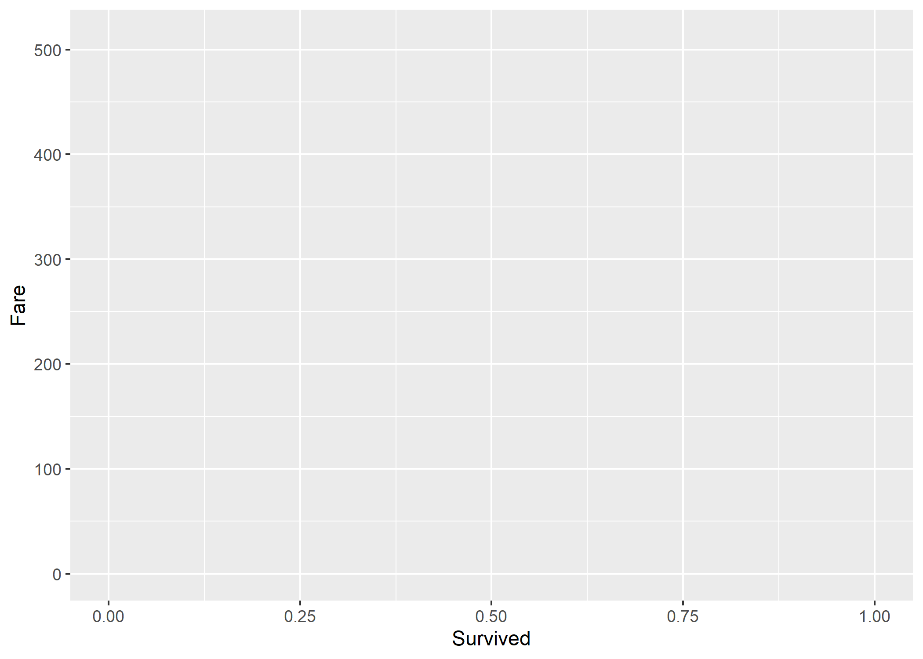

Slide 15
Survived is being treated as a continuous variable
titanic %>% select(Survived)
## # A tibble: 891 x 1 ## Survived ## <dbl> ## 1 0 ## 2 1 ## 3 1 ## 4 1 ## 5 0 ## 6 0 ## 7 0 ## 8 0 ## 9 1 ## 10 1 ## # ... with 881 more rows

Slide 16
Factorizing Survived to make it discrete
titanic %>%
ggplot(mapping = aes(x = factor(Survived), y = Fare))

Slide 17
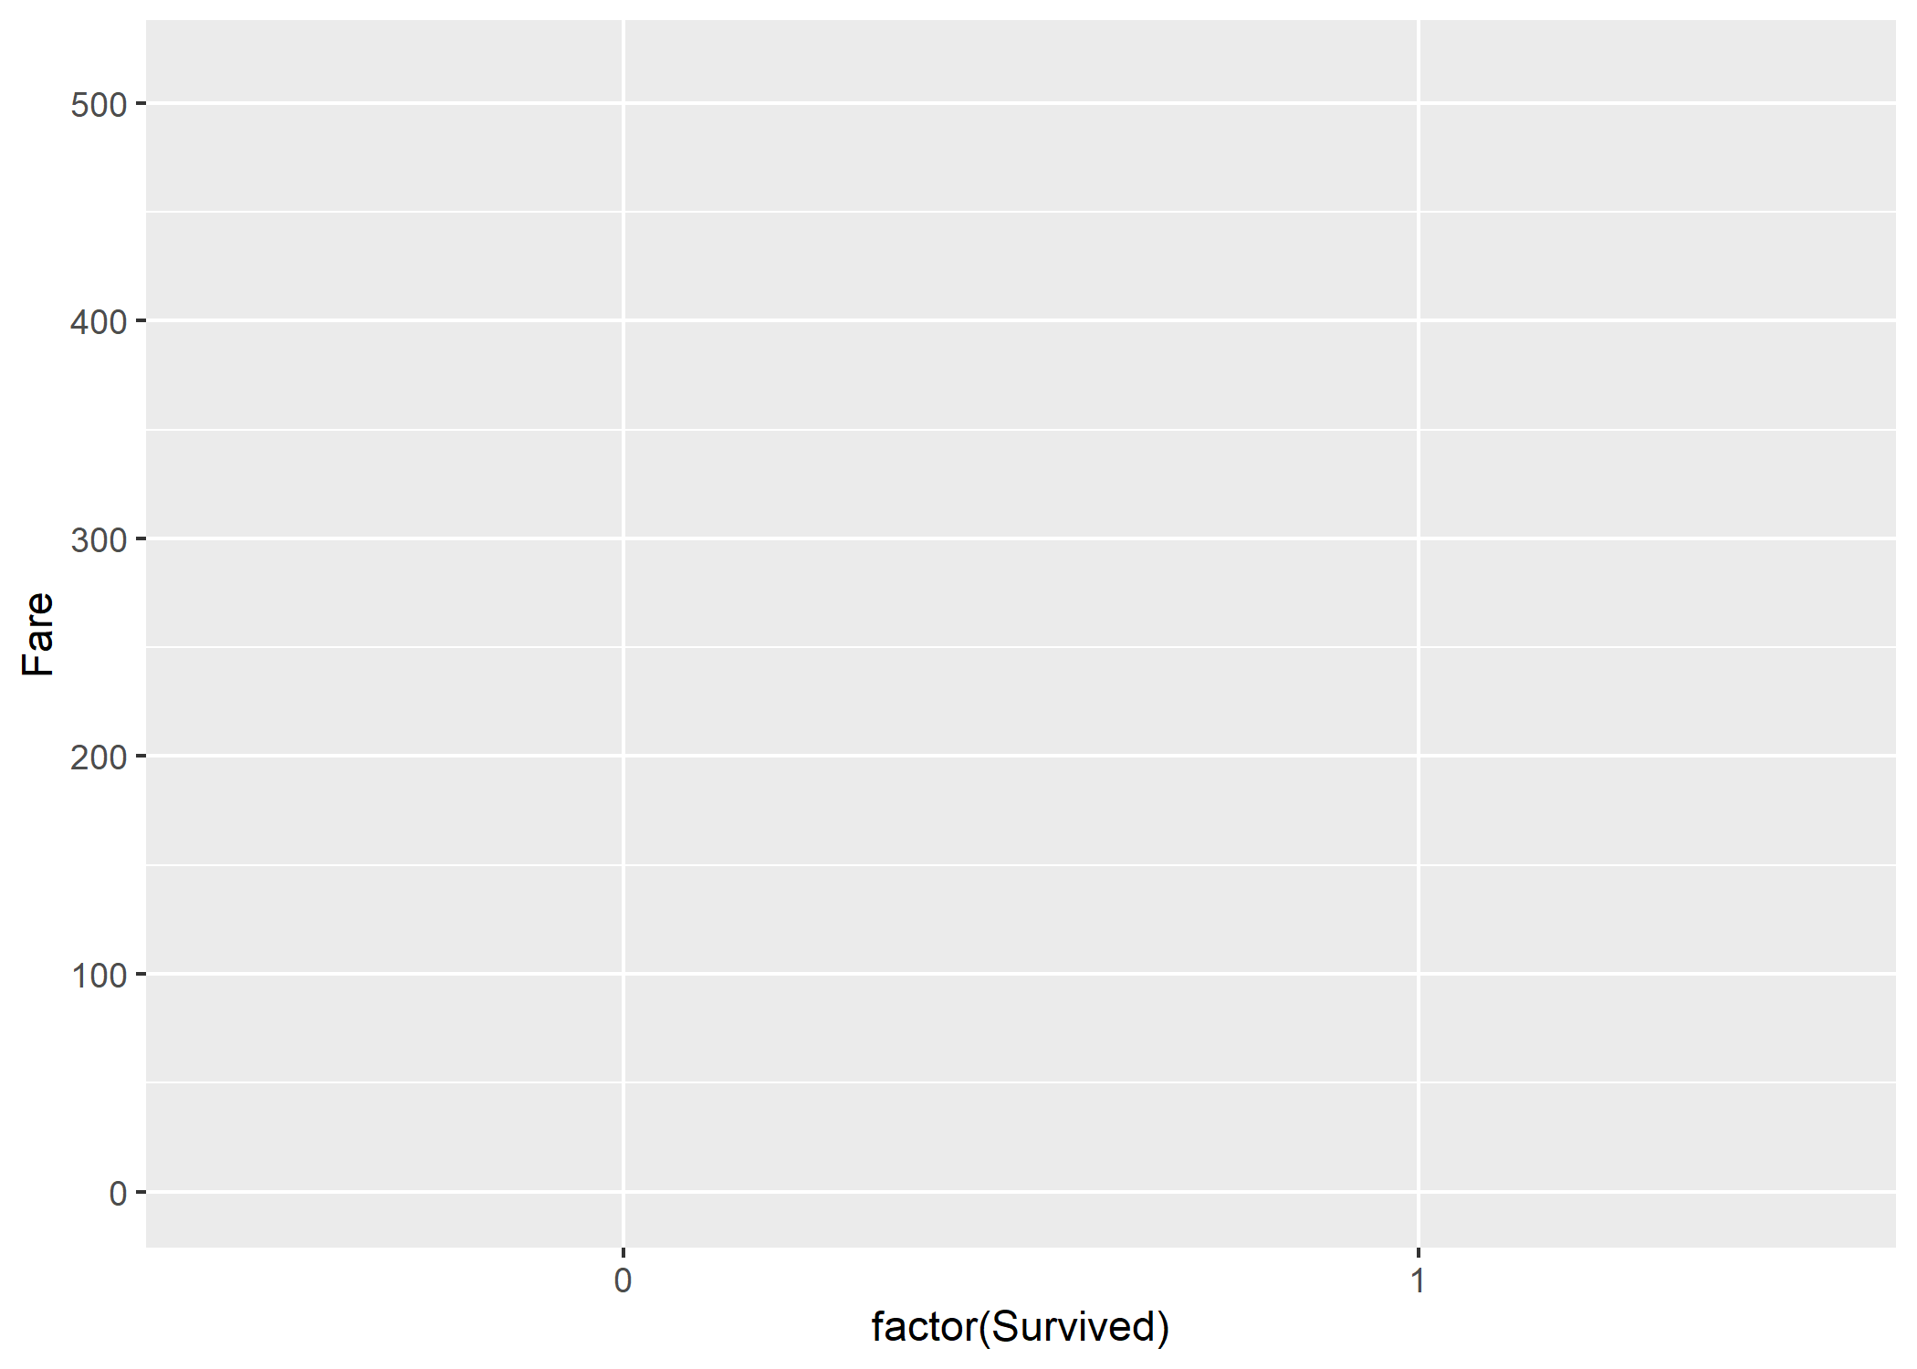

Slide 18
Add factor labels to improve readability
titanic %>%
ggplot(mapping = aes(x = factor(Survived, labels = c("Died", "Survived")), y = Fare))

Slide 19
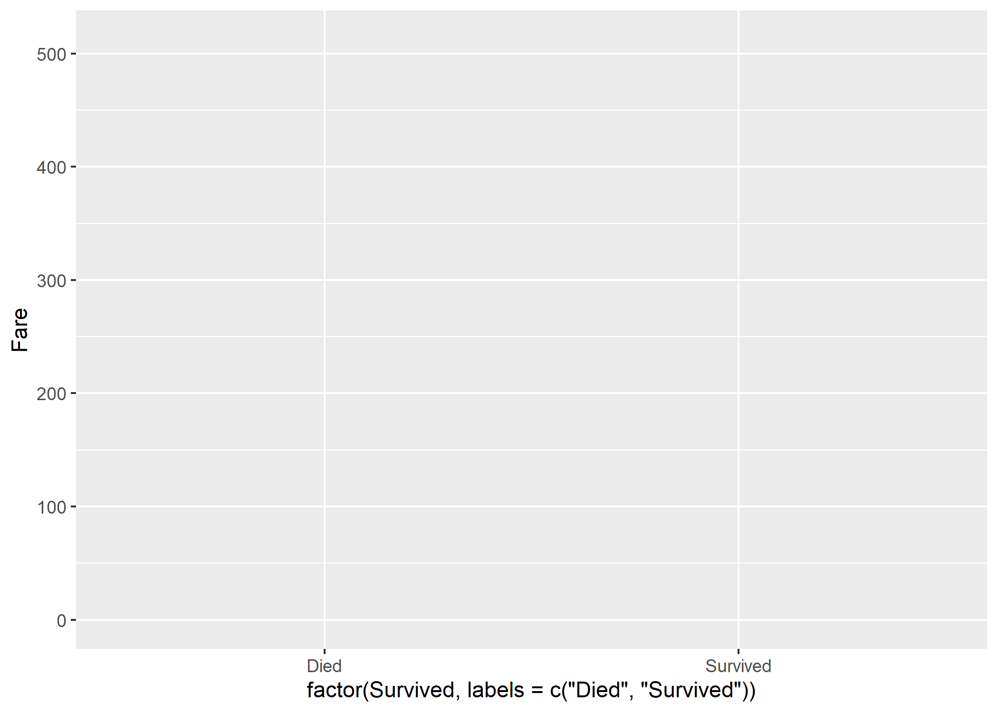

Slide 20
Add the geometry layer
titanic %>%
ggplot(mapping = aes(x = factor(Survived, labels = c("Died", "Survived")), y = Fare)) +
geom_boxplot()

Slide 21
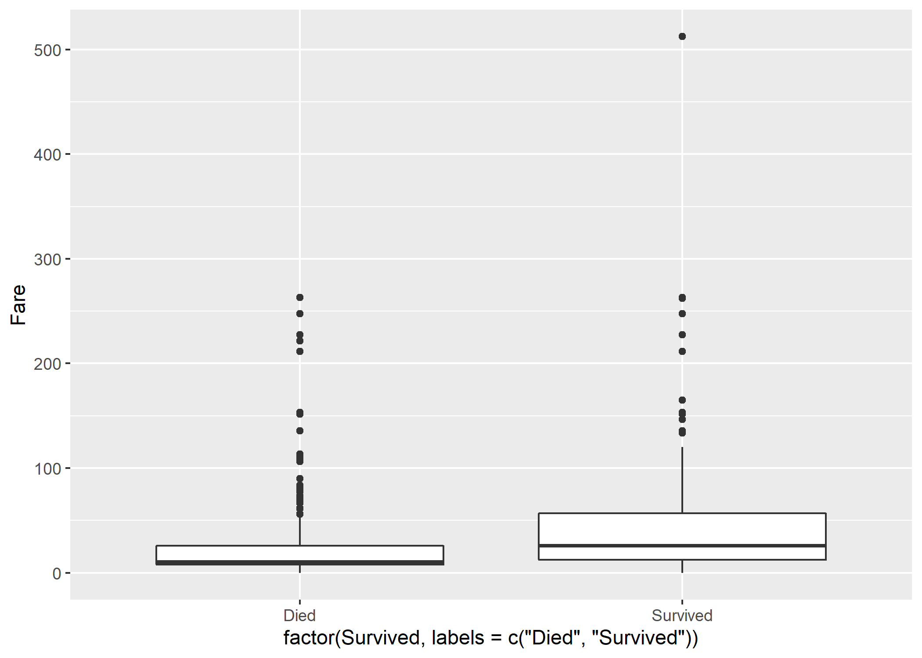

Slide 22
Coordinates: log-scale for y-axis
titanic %>%
ggplot(mapping = aes(x = factor(Survived, labels = c("Died", "Survived")), y = Fare)) +
geom_boxplot() +
scale_y_log10()

Slide 23
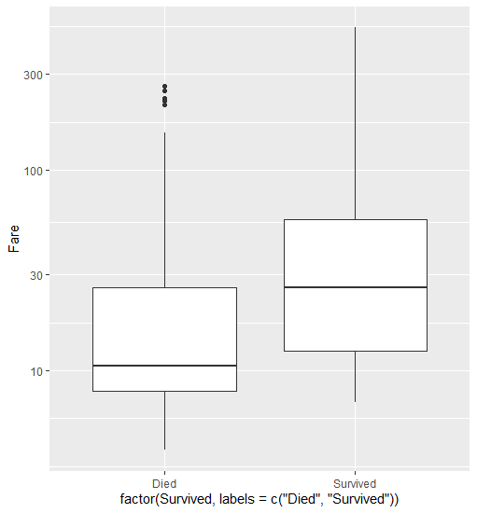

Slide 24
Filter out rows without Fare data
titanic %>%
filter(Fare > 0) %>%
ggplot(mapping = aes(x = factor(Survived, labels = c("Died", "Survived")), y = Fare)) +
geom_boxplot() +
scale_y_log10()

Slide 26
Install and load ggpubr
# install.packages("ggpubr") library(ggpubr)

Slide 27
Add a t-test to the plot
titanic %>%
filter(Fare > 0) %>%
ggplot(mapping = aes(x = factor(Survived, labels = c("Died", "Survived")), y = Fare)) +
geom_boxplot() +
scale_y_log10() +
stat_compare_means(method = "t.test")

Slide 28
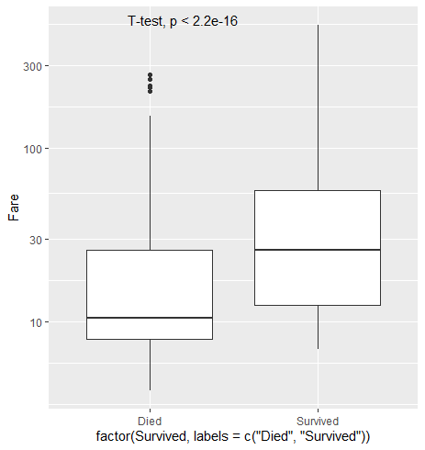

Slide 29
Make a reader-friendly label
titanic %>%
filter(Fare > 0) %>%
ggplot(mapping = aes(x = factor(Survived, labels = c("Died", "Survived")), y = Fare)) +
geom_boxplot() +
scale_y_log10() +
stat_compare_means(method = "t.test", label = "p.signif")

Slide 30
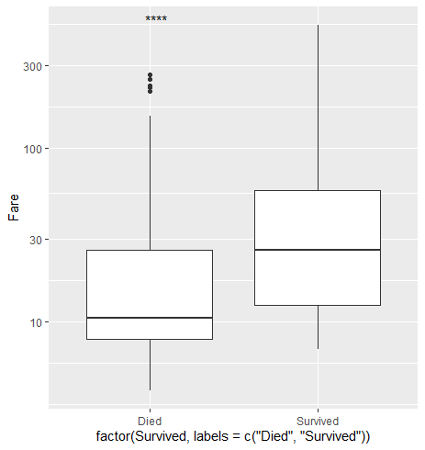

Slide 31
Add comparison brackets
titanic %>%
filter(Fare > 0) %>%
ggplot(mapping = aes(x = factor(Survived, labels = c("Died", "Survived")), y = Fare)) +
geom_boxplot() +
scale_y_log10() +
stat_compare_means(method = "t.test", label = "p.signif", comparisons = list(c("Died", "Survived")))

Slide 32
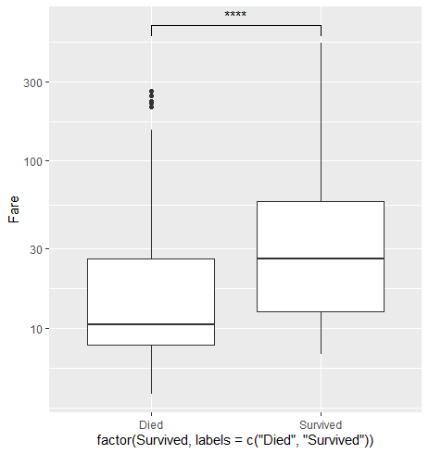

Slide 33
Improve the overall appearance
titanic %>%
filter(Fare > 0) %>%
ggplot(mapping = aes(x = factor(Survived, labels = c("Died", "Survived")), y = Fare)) +
geom_boxplot() +
scale_y_log10() +
stat_compare_means(method = "t.test", label = "p.signif", comparisons = list(c("Died", "Survived"))) +
xlab(NULL) +
ylab("Ticket Price") +
theme_bw(base_size = 17) +
ggsave(filename = "my_figure.png", height = 5, width = 5)

Slide 34
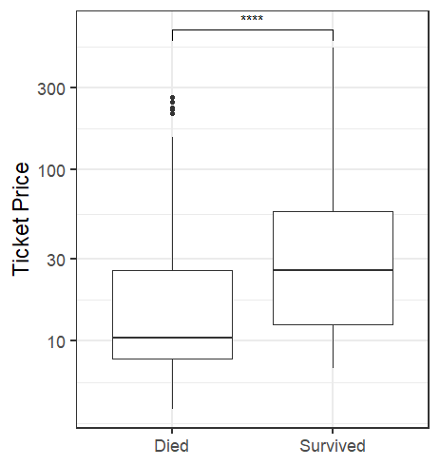

Slide 35
Analyzing biomedical data with tidyverse and ggpubr
Using luminescence data from a plate reader

Slide 36
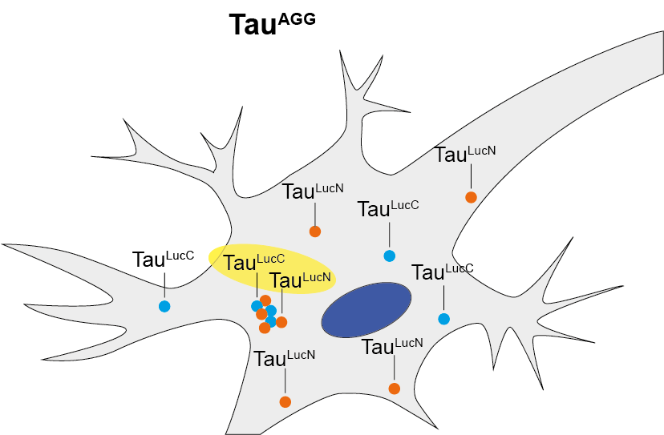
Measuring tau aggregation via luminescence
Tau is fused to luciferase fragments
Aggregating tau reconstitutes luciferase activity
Feeding flies substrate produces light detected by plate reader
EGFP should not aggregate ➔ Control

Slide 37
Read in the data
luminescence <- read_csv(file = "Luminescence Quick Read 2021.04.12 14_13_35.csv")
# A tibble: 18 x 8
ID SequenceID WellPosition ScanPosition Tag RLU `RLU(RQ)` `Timestamp(ms)`
<chr> <dbl> <chr> <lgl> <lgl> <dbl> <chr> <dbl>
1 b29a03ef-8b8d-4f8e-b14c-2b87ebf090ce 0 A:1 NA NA 1795 ValidSlopeSaturation 788927327
2 b29a03ef-8b8d-4f8e-b14c-2b87ebf090ce 0 A:2 NA NA 1564 ValidSlopeSaturation 788937577
3 b29a03ef-8b8d-4f8e-b14c-2b87ebf090ce 0 A:3 NA NA 2984 ValidSlopeSaturation 788947828
4 b29a03ef-8b8d-4f8e-b14c-2b87ebf090ce 0 A:4 NA NA 2330 ValidSlopeSaturation 788958123
5 b29a03ef-8b8d-4f8e-b14c-2b87ebf090ce 0 A:5 NA NA 1819 ValidSlopeSaturation 788968376
...

Slide 38
Specify the plate layout
plate_layout <- data.frame(Row = c("A", "B", "C"), Genotpye = c("tau_AGG", "EGPF_AGG_1", "EGFP_AGG_2")
Row Genotype
1 A tau_AGG
2 B EGFP_AGG_1
3 C EGFP_AGG_2

Slide 39
Parse well position into row and column
luminescence %>%
mutate(Row = substr(WellPosition, 1, 1)) %>%
mutate(Column = substr(WellPosition, 3, 3))

Slide 40
Parse well position into row and column
luminescence %>%
mutate(Row = substr(WellPosition, 1, 1)) %>%
mutate(Column = substr(WellPosition, 3, 3))
# A tibble: 18 x 10
ID SequenceID WellPosition ScanPosition Tag RLU `RLU(RQ)` `Timestamp(ms)` Row Column
<chr> <dbl> <chr> <lgl> <lgl> <dbl> <chr> <dbl> <chr> <chr>
1 b29a03ef-8b8d-4f8e-b14c-2b87ebf090ce 0 A:1 NA NA 1795 ValidSlopeSaturation 788927327 A 1
2 b29a03ef-8b8d-4f8e-b14c-2b87ebf090ce 0 A:2 NA NA 1564 ValidSlopeSaturation 788937577 A 2
3 b29a03ef-8b8d-4f8e-b14c-2b87ebf090ce 0 A:3 NA NA 2984 ValidSlopeSaturation 788947828 A 3
4 b29a03ef-8b8d-4f8e-b14c-2b87ebf090ce 0 A:4 NA NA 2330 ValidSlopeSaturation 788958123 A 4
5 b29a03ef-8b8d-4f8e-b14c-2b87ebf090ce 0 A:5 NA NA 1819 ValidSlopeSaturation 788968376 A 5
6 b29a03ef-8b8d-4f8e-b14c-2b87ebf090ce 0 A:6 NA NA 1509 ValidSlopeSaturation 788978628 A 6
7 b29a03ef-8b8d-4f8e-b14c-2b87ebf090ce 0 B:1 NA NA 1515 ValidSlopeSaturation 788989313 B 1
8 b29a03ef-8b8d-4f8e-b14c-2b87ebf090ce 0 B:2 NA NA 1024 ValidSlopeSaturation 788999567 B 2
9 b29a03ef-8b8d-4f8e-b14c-2b87ebf090ce 0 B:3 NA NA 1580 ValidSlopeSaturation 789009818 B 3
10 b29a03ef-8b8d-4f8e-b14c-2b87ebf090ce 0 B:4 NA NA 1453 ValidSlopeSaturation 789020127 B 4
11 b29a03ef-8b8d-4f8e-b14c-2b87ebf090ce 0 B:5 NA NA 1628 ValidSlopeSaturation 789030381 B 5
12 b29a03ef-8b8d-4f8e-b14c-2b87ebf090ce 0 B:6 NA NA 1115 ValidSlopeSaturation 789040626 B 6
13 b29a03ef-8b8d-4f8e-b14c-2b87ebf090ce 0 C:1 NA NA 796 ValidSlopeSaturation 789051308 C 1
14 b29a03ef-8b8d-4f8e-b14c-2b87ebf090ce 0 C:2 NA NA 818 ValidSlopeSaturation 789061558 C 2
15 b29a03ef-8b8d-4f8e-b14c-2b87ebf090ce 0 C:3 NA NA 375 ValidSlopeSaturation 789071804 C 3
16 b29a03ef-8b8d-4f8e-b14c-2b87ebf090ce 0 C:4 NA NA 765 ValidSlopeSaturation 789082104 C 4
17 b29a03ef-8b8d-4f8e-b14c-2b87ebf090ce 0 C:5 NA NA 858 ValidSlopeSaturation 789092354 C 5
18 b29a03ef-8b8d-4f8e-b14c-2b87ebf090ce 0 C:6 NA NA 1194 ValidSlopeSaturation 789102600 C 6
>

Slide 41
Select relevant data
luminescence %>%
mutate(Row = substr(WellPosition, 1, 1)) %>%
mutate(Column = substr(WellPosition, 3, 3)) %>%
select(Luminescence = "RLU", Row, Column)

Slide 42
Select relevant data
luminescence %>%
mutate(Row = substr(WellPosition, 1, 1)) %>%
mutate(Column = substr(WellPosition, 3, 3)) %>%
select(Luminescence = "RLU", Row, Column)
# A tibble: 18 x 3
Luminescence Row Column
<dbl> <chr> <chr>
1 1795 A 1
2 1564 A 2
3 2984 A 3
4 2330 A 4
5 1819 A 5
6 1509 A 6
7 1515 B 1
8 1024 B 2
9 1580 B 3
10 1453 B 4
11 1628 B 5
12 1115 B 6
13 796 C 1
14 818 C 2
15 375 C 3
16 765 C 4
17 858 C 5
18 1194 C 6

Slide 43
Merge plate layout
luminescence %>%
mutate(Row = substr(WellPosition, 1, 1)) %>%
mutate(Column = substr(WellPosition, 3, 3)) %>%
select(Luminescence = "RLU", Row, Column) %>%
left_join(plate_layout, by = "Row")

Slide 44
Merge plate layout
luminescence %>%
mutate(Row = substr(WellPosition, 1, 1)) %>%
mutate(Column = substr(WellPosition, 3, 3)) %>%
select(Luminescence = "RLU", Row, Column) %>%
left_join(plate_layout, by = "Row")
# A tibble: 18 x 4
Luminescence Row Column Genotype
<dbl> <chr> <chr> <chr>
1 1795 A 1 tau_AGG
2 1564 A 2 tau_AGG
3 2984 A 3 tau_AGG
4 2330 A 4 tau_AGG
5 1819 A 5 tau_AGG
6 1509 A 6 tau_AGG
7 1515 B 1 EGFP_AGG_1
8 1024 B 2 EGFP_AGG_1
9 1580 B 3 EGFP_AGG_1
10 1453 B 4 EGFP_AGG_1
11 1628 B 5 EGFP_AGG_1
12 1115 B 6 EGFP_AGG_1
13 796 C 1 EGFP_AGG_2
14 818 C 2 EGFP_AGG_2
15 375 C 3 EGFP_AGG_2
16 765 C 4 EGFP_AGG_2
17 858 C 5 EGFP_AGG_2
18 1194 C 6 EGFP_AGG_2

Slide 45
Group by genotype
luminescence %>%
mutate(Row = substr(WellPosition, 1, 1)) %>%
mutate(Column = substr(WellPosition, 3, 3)) %>%
select(Luminescence = "RLU", Row, Column) %>%
left_join(plate_layout, by = "Row") %>%
group_by(Genotype)

Slide 46
Calculate mean within groups
luminescence %>%
mutate(Row = substr(WellPosition, 1, 1)) %>%
mutate(Column = substr(WellPosition, 3, 3)) %>%
select(Luminescence = "RLU", Row, Column) %>%
left_join(plate_layout, by = "Row") %>%
group_by(Genotype) %>%
mutate(Luminescence_Mean = mean(Luminescence))
# A tibble: 18 x 5
# Groups: Genotype [3]
Luminescence Row Column Genotype Luminescence_Mean
<dbl> <chr> <chr> <chr> <dbl>
1 1795 A 1 tau_AGG 2000.
2 1564 A 2 tau_AGG 2000.
3 2984 A 3 tau_AGG 2000.
4 2330 A 4 tau_AGG 2000.
5 1819 A 5 tau_AGG 2000.
6 1509 A 6 tau_AGG 2000.
7 1515 B 1 EGFP_AGG_1 1386.
8 1024 B 2 EGFP_AGG_1 1386.
9 1580 B 3 EGFP_AGG_1 1386.
10 1453 B 4 EGFP_AGG_1 1386.
11 1628 B 5 EGFP_AGG_1 1386.
12 1115 B 6 EGFP_AGG_1 1386.
13 796 C 1 EGFP_AGG_2 801
14 818 C 2 EGFP_AGG_2 801
15 375 C 3 EGFP_AGG_2 801
16 765 C 4 EGFP_AGG_2 801
17 858 C 5 EGFP_AGG_2 801
18 1194 C 6 EGFP_AGG_2 801

Slide 47
Calculate SD within groups
luminescence %>%
mutate(Row = substr(WellPosition, 1, 1)) %>%
mutate(Column = substr(WellPosition, 3, 3)) %>%
select(Luminescence = "RLU", Row, Column) %>%
left_join(plate_layout, by = "Row") %>%
group_by(Genotype) %>%
mutate(Luminescence_Mean = mean(Luminescence)) %>%
mutate(Luminescence_Stdev = sd(Luminescence))

Slide 48
Calculate SD within groups
luminescence %>%
mutate(Row = substr(WellPosition, 1, 1)) %>%
mutate(Column = substr(WellPosition, 3, 3)) %>%
select(Luminescence = "RLU", Row, Column) %>%
left_join(plate_layout, by = "Row") %>%
group_by(Genotype) %>%
mutate(Luminescence_Mean = mean(Luminescence)) %>%
mutate(Luminescence_Stdev = sd(Luminescence))
# A tibble: 18 x 6
# Groups: Genotype [3]
Luminescence Row Column Genotype Luminescence_Mean Luminescence_Stdev
<dbl> <chr> <chr> <chr> <dbl> <dbl>
1 1795 A 1 tau_AGG 2000. 563.
2 1564 A 2 tau_AGG 2000. 563.
3 2984 A 3 tau_AGG 2000. 563.
4 2330 A 4 tau_AGG 2000. 563.
5 1819 A 5 tau_AGG 2000. 563.
6 1509 A 6 tau_AGG 2000. 563.
7 1515 B 1 EGFP_AGG_1 1386. 254.
8 1024 B 2 EGFP_AGG_1 1386. 254.
9 1580 B 3 EGFP_AGG_1 1386. 254.
10 1453 B 4 EGFP_AGG_1 1386. 254.
11 1628 B 5 EGFP_AGG_1 1386. 254.
12 1115 B 6 EGFP_AGG_1 1386. 254.
13 796 C 1 EGFP_AGG_2 801 261.
14 818 C 2 EGFP_AGG_2 801 261.
15 375 C 3 EGFP_AGG_2 801 261.
16 765 C 4 EGFP_AGG_2 801 261.
17 858 C 5 EGFP_AGG_2 801 261.
18 1194 C 6 EGFP_AGG_2 801 261.

Slide 49
Calculate SEM within groups
luminescence %>%
mutate(Row = substr(WellPosition, 1, 1)) %>%
mutate(Column = substr(WellPosition, 3, 3)) %>%
select(Luminescence = "RLU", Row, Column) %>%
left_join(plate_layout, by = "Row") %>%
group_by(Genotype) %>%
mutate(Luminescence_Mean = mean(Luminescence)) %>%
mutate(Luminescence_Stdev = sd(Luminescence)) %>%
mutate(Luminescence_SEM = Luminescence_Stdev/sqrt(n()))

Slide 50
Calculate SEM within groups
luminescence %>%
mutate(Row = substr(WellPosition, 1, 1)) %>%
mutate(Column = substr(WellPosition, 3, 3)) %>%
select(Luminescence = "RLU", Row, Column) %>%
left_join(plate_layout, by = "Row") %>%
group_by(Genotype) %>%
mutate(Luminescence_Mean = mean(Luminescence)) %>%
mutate(Luminescence_Stdev = sd(Luminescence)) %>%
mutate(Luminescence_SEM = Luminescence_Stdev/sqrt(n()))
# A tibble: 18 x 7
# Groups: Genotype [3]
Luminescence Row Column Genotype Luminescence_Mean Luminescence_Stdev Luminescence_SEM
<dbl> <chr> <chr> <chr> <dbl> <dbl> <dbl>
1 1795 A 1 tau_AGG 2000. 563. 230.
2 1564 A 2 tau_AGG 2000. 563. 230.
3 2984 A 3 tau_AGG 2000. 563. 230.
4 2330 A 4 tau_AGG 2000. 563. 230.
5 1819 A 5 tau_AGG 2000. 563. 230.
6 1509 A 6 tau_AGG 2000. 563. 230.
7 1515 B 1 EGFP_AGG_1 1386. 254. 104.
8 1024 B 2 EGFP_AGG_1 1386. 254. 104.
9 1580 B 3 EGFP_AGG_1 1386. 254. 104.
10 1453 B 4 EGFP_AGG_1 1386. 254. 104.
11 1628 B 5 EGFP_AGG_1 1386. 254. 104.
12 1115 B 6 EGFP_AGG_1 1386. 254. 104.
13 796 C 1 EGFP_AGG_2 801 261. 107.
14 818 C 2 EGFP_AGG_2 801 261. 107.
15 375 C 3 EGFP_AGG_2 801 261. 107.
16 765 C 4 EGFP_AGG_2 801 261. 107.
17 858 C 5 EGFP_AGG_2 801 261. 107.
18 1194 C 6 EGFP_AGG_2 801 261. 107.

Slide 51
Pipe tidy data to ggplot
luminescence %>%
mutate(Row = substr(WellPosition, 1, 1)) %>%
mutate(Column = substr(WellPosition, 3, 3)) %>%
select(Luminescence = "RLU", Row, Column) %>%
left_join(plate_layout, by = "Row") %>%
group_by(Genotype) %>%
mutate(Luminescence_Mean = mean(Luminescence)) %>%
mutate(Luminescence_Stdev = sd(Luminescence)) %>%
mutate(Luminescence_SEM = Luminescence_Stdev/sqrt(n())) %>%
ggplot(mapping = aes(x = factor(Genotype, levels = c("tau_AGG", "EGFP_AGG_1", "EGFP_AGG_2")), y = Luminescence))

Slide 52
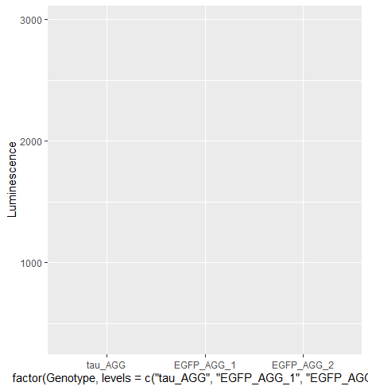

Slide 53
Add geometry
luminescence %>%
mutate(Row = substr(WellPosition, 1, 1)) %>%
mutate(Column = substr(WellPosition, 3, 3)) %>%
select(Luminescence = "RLU", Row, Column) %>%
left_join(plate_layout, by = "Row") %>%
group_by(Genotype) %>%
mutate(Luminescence_Mean = mean(Luminescence)) %>%
mutate(Luminescence_Stdev = sd(Luminescence)) %>%
mutate(Luminescence_SEM = Luminescence_Stdev/sqrt(n())) %>%
ggplot(mapping = aes(x = factor(Genotype, levels = c("tau_AGG", "EGFP_AGG_1", "EGFP_AGG_2")), y = Luminescence)) +
geom_bar(stat = "summary", fun = "mean")

Slide 54
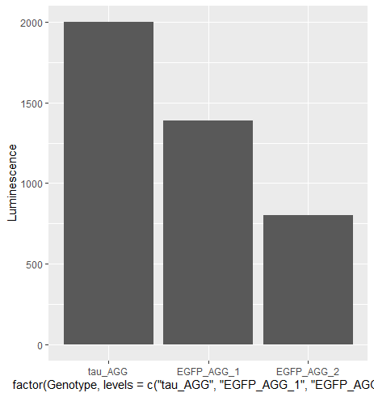

Slide 55
Add errorbars
luminescence %>%
mutate(Row = substr(WellPosition, 1, 1)) %>%
mutate(Column = substr(WellPosition, 3, 3)) %>%
select(Luminescence = "RLU", Row, Column) %>%
left_join(plate_layout, by = "Row") %>%
group_by(Genotype) %>%
mutate(Luminescence_Mean = mean(Luminescence)) %>%
mutate(Luminescence_Stdev = sd(Luminescence)) %>%
mutate(Luminescence_SEM = Luminescence_Stdev/sqrt(n())) %>%
ggplot(mapping = aes(x = factor(Genotype, levels = c("tau_AGG", "EGFP_AGG_1", "EGFP_AGG_2")), y = Luminescence)) +
geom_bar(stat = "summary", fun = "mean") +
geom_errorbar(aes(ymin = Luminescence_Mean - Luminescence_SEM, ymax = Luminescence_Mean + Luminescence_SEM))

Slide 56
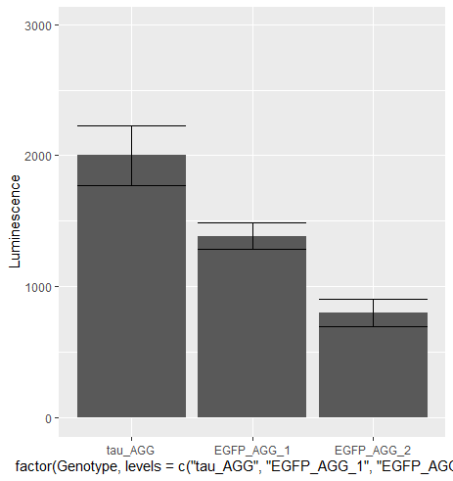

Slide 57
Improve appearance
luminescence %>%
mutate(Row = substr(WellPosition, 1, 1)) %>%
mutate(Column = substr(WellPosition, 3, 3)) %>%
select(Luminescence = "RLU", Row, Column) %>%
left_join(plate_layout, by = "Row") %>%
group_by(Genotype) %>%
mutate(Luminescence_Mean = mean(Luminescence)) %>%
mutate(Luminescence_Stdev = sd(Luminescence)) %>%
mutate(Luminescence_SEM = Luminescence_Stdev/sqrt(n())) %>%
ggplot(mapping = aes(x = factor(Genotype, levels = c("tau_AGG", "EGFP_AGG_1", "EGFP_AGG_2")), y = Luminescence)) +
geom_bar(stat = "summary", fun = "mean") +
geom_errorbar(aes(ymin = Luminescence_Mean - Luminescence_SEM, ymax = Luminescence_Mean + Luminescence_SEM)) +
xlab("Genotype") +
ylab("Luminescence") +
labs(title = "Comparison of tau aggregation to EGFP controls") +
theme_classic()

Slide 58
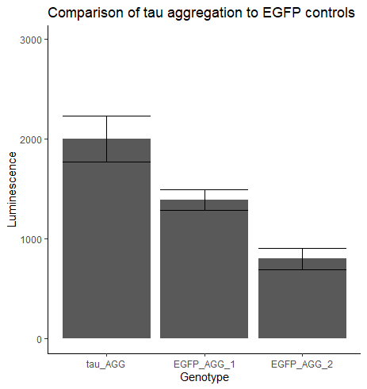

Slide 59
Add ANOVA
luminescence %>%
mutate(Row = substr(WellPosition, 1, 1)) %>%
mutate(Column = substr(WellPosition, 3, 3)) %>%
select(Luminescence = "RLU", Row, Column) %>%
left_join(plate_layout, by = "Row") %>%
group_by(Genotype) %>%
mutate(Luminescence_Mean = mean(Luminescence)) %>%
mutate(Luminescence_Stdev = sd(Luminescence)) %>%
mutate(Luminescence_SEM = Luminescence_Stdev/sqrt(n())) %>%
ggplot(mapping = aes(x = factor(Genotype, levels = c("tau_AGG", "EGFP_AGG_1", "EGFP_AGG_2")), y = Luminescence)) +
geom_bar(stat = "summary", fun = "mean") +
geom_errorbar(aes(ymin = Luminescence_Mean - Luminescence_SEM, ymax = Luminescence_Mean + Luminescence_SEM)) +
xlab("Genotype") +
ylab("Luminescence") +
labs(title = "Comparison of tau aggregation to EGFP controls") +
theme_classic() +
stat_compare_means(method = "anova", label.y = 3700)

Slide 60
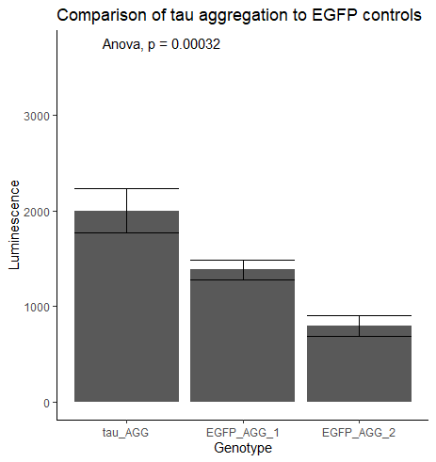

Slide 61
Add pairwise comparisons and save
luminescence %>%
mutate(Row = substr(WellPosition, 1, 1)) %>%
mutate(Column = substr(WellPosition, 3, 3)) %>%
select(Luminescence = "RLU", Row, Column) %>%
left_join(plate_layout, by = "Row") %>%
group_by(Genotype) %>%
mutate(Luminescence_Mean = mean(Luminescence)) %>%
mutate(Luminescence_Stdev = sd(Luminescence)) %>%
mutate(Luminescence_SEM = Luminescence_Stdev/sqrt(n())) %>%
ggplot(mapping = aes(x = factor(Genotype, levels = c("tau_AGG", "EGFP_AGG_1", "EGFP_AGG_2")), y = Luminescence)) +
geom_bar(stat = "summary", fun = "mean") +
geom_errorbar(aes(ymin = Luminescence_Mean - Luminescence_SEM, ymax = Luminescence_Mean + Luminescence_SEM)) +
xlab("Genotype") +
ylab("Luminescence") +
labs(title = "Comparison of tau aggregation to EGFP controls") +
theme_classic() +
stat_compare_means(method = "anova", label.y = 3700) +
stat_compare_means(method = "t.test", comparisons = list(c("tau_AGG", "EGFP_AGG_1"), c("tau_AGG", "EGFP_AGG_2")), label = "p.signif") +
ggsave("Raw_Luminescence.png")

Slide 62


Slide 63
Do the same thing, but normalize to tau_AGG
luminescence %>%
mutate(Row = substr(WellPosition, 1, 1)) %>%
mutate(Column = substr(WellPosition, 3, 3)) %>%
select(Luminescence = "RLU", Row, Column) %>%
left_join(plate_layout, by = "Row") %>%
mutate(Luminescence_Norm = Luminescence/mean(Luminescence[Genotype == "tau_AGG"])) %>%
group_by(Genotype) %>%
mutate(Luminescence_Norm_Mean = mean(Luminescence_Norm)) %>%
mutate(Luminescence_Norm_Stdev = sd(Luminescence_Norm)) %>%
mutate(Luminescence_Norm_SEM = Luminescence_Norm_Stdev/sqrt(n())) %>%
ggplot(mapping = aes(x = factor(Genotype, levels = c("tau_AGG", "EGFP_AGG_1", "EGFP_AGG_2")), y = Luminescence_Norm)) +
geom_bar(stat = "summary", fun = "mean") +
geom_errorbar(aes(ymin = Luminescence_Norm_Mean – Luminescence_Norm_SEM, ymax = Luminescence_Norm_Mean + Luminescence_Norm_SEM)) +
xlab("Genotype") +
ylab("Luminescence (normalized to tau_AGG") +
labs(title = "Comparison of tau aggregation to EGFP controls") +
theme_classic() +
stat_compare_means(method = "anova", label.y = 3700) +
stat_compare_means(method = "t.test", comparisons = list(c("tau_AGG", "EGFP_AGG_1"), c("tau_AGG", "EGFP_AGG_2")), label = "p.signif") +
ggsave("Normalized_Luminescence.png")

Slide 64
